Slide 1
Microglia Project Progress 07/12/20 Update
Maya Garg

Slide 2
Motivation
Use the heatmaps and clustered data to identify an immune/macrophage/microglia cluster based on microglial gene marker expression
Once cluster is identified → assign a probability score to cells in selected cluster “how likely is it that this cell is a microglia?”
Even cells with low probability due to low expression may be microglia (just inactivated)
Force same gene order across selected clusters in heatmap to look for patterns

Slide 3
Methods (To date)
Started by researching (using online databases) about microglia and microglial gene markers
Compiled gene markers and extracted from gene expression matrix in GEO dataset
Selected 3 samples for each subtype of MB
Criteria was as follows:
Total samples available: 36
Of the 36: 25 MB patient samples, 11 patient derived xenograft models
Of the 25 MB patients: 23 diagnostic samples and 2 recurrences
For the sake of maintaining similar conditions across trials: All samples used are diagnostic MB patient samples
Generated clustered heat maps for each sample
Isolate each cluster for each sample (extract cluster as separate matrices)
Identify immune/macrophage/microglia (IMM) cluster for each sample → while I was looking for more markers I cam across a few more that I added, which altered the heatmaps, they are included.
To determine which cluster is the (IMM) cluster, look at the average microglial gene expression in each cluster (just sum all of the values in the matrix and divide by the number of cells in the cluster; this is so that a larger cluster doesn’t come out as the highest expression due to the number of cells) and the one with the highest expression level should be the IMM cluster because the matrix only includes microglial gene expression markers which should be upregulated for IMM related cells
Using predetermined data and literature, order the cells in the IMM cluster in terms of likelihood of being a microglial cell → next steps
In the IMM clusters, look at the expression of these particular microglia specific markers and then order the cells in terms of the gene expression from high to low. (or probability score)?

Slide 4
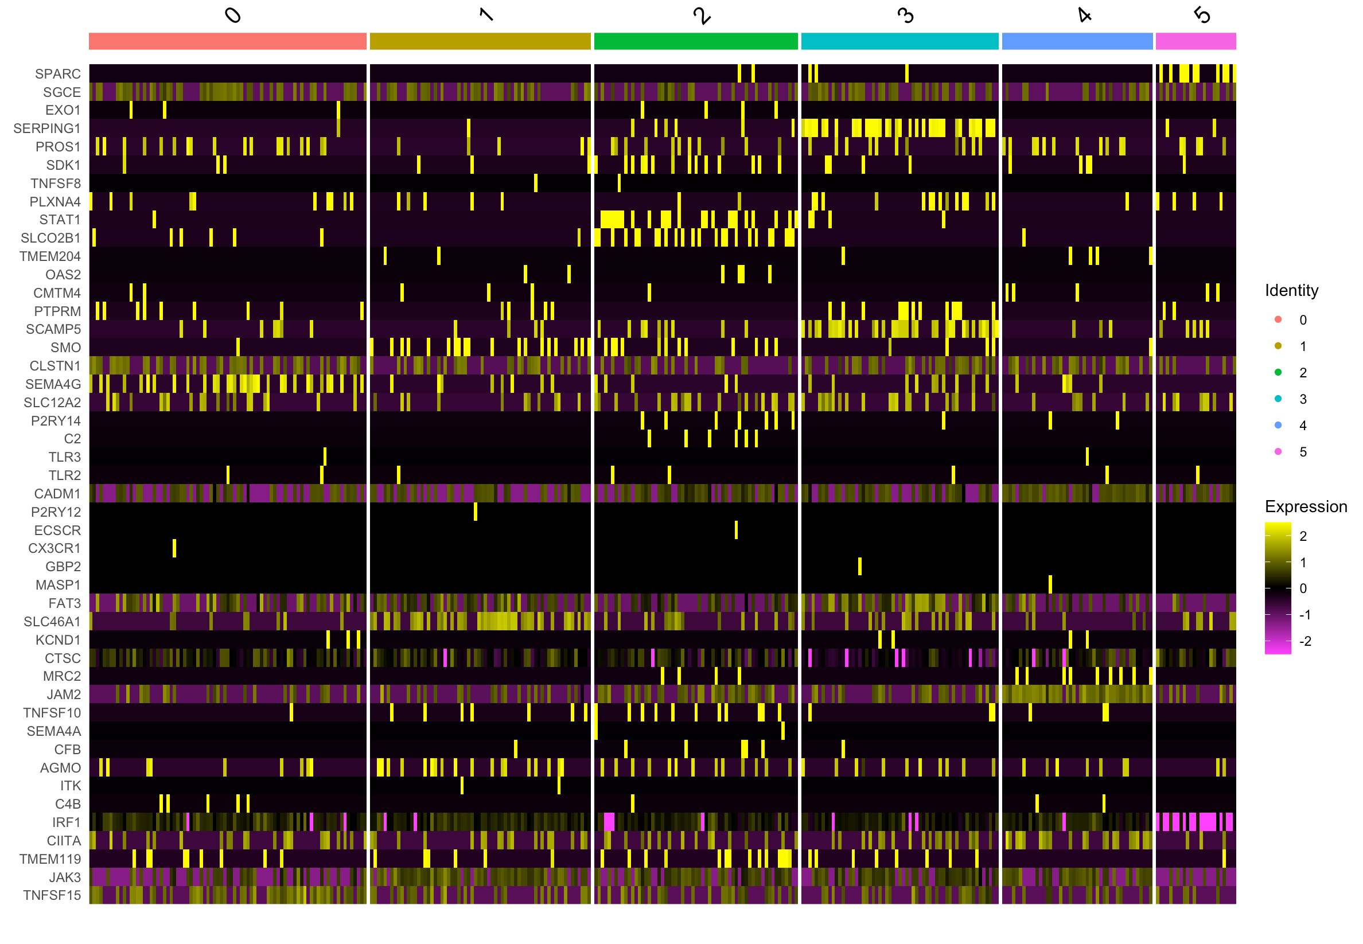
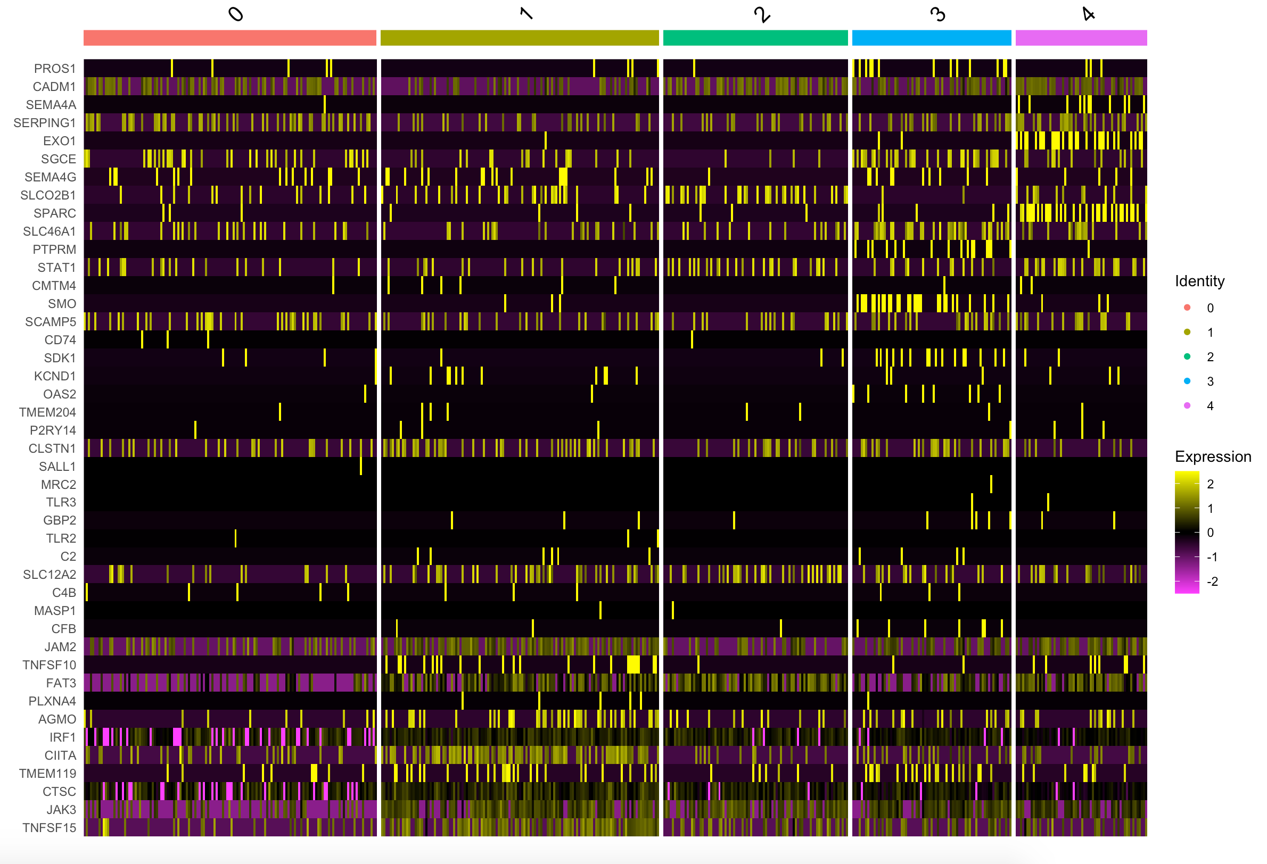
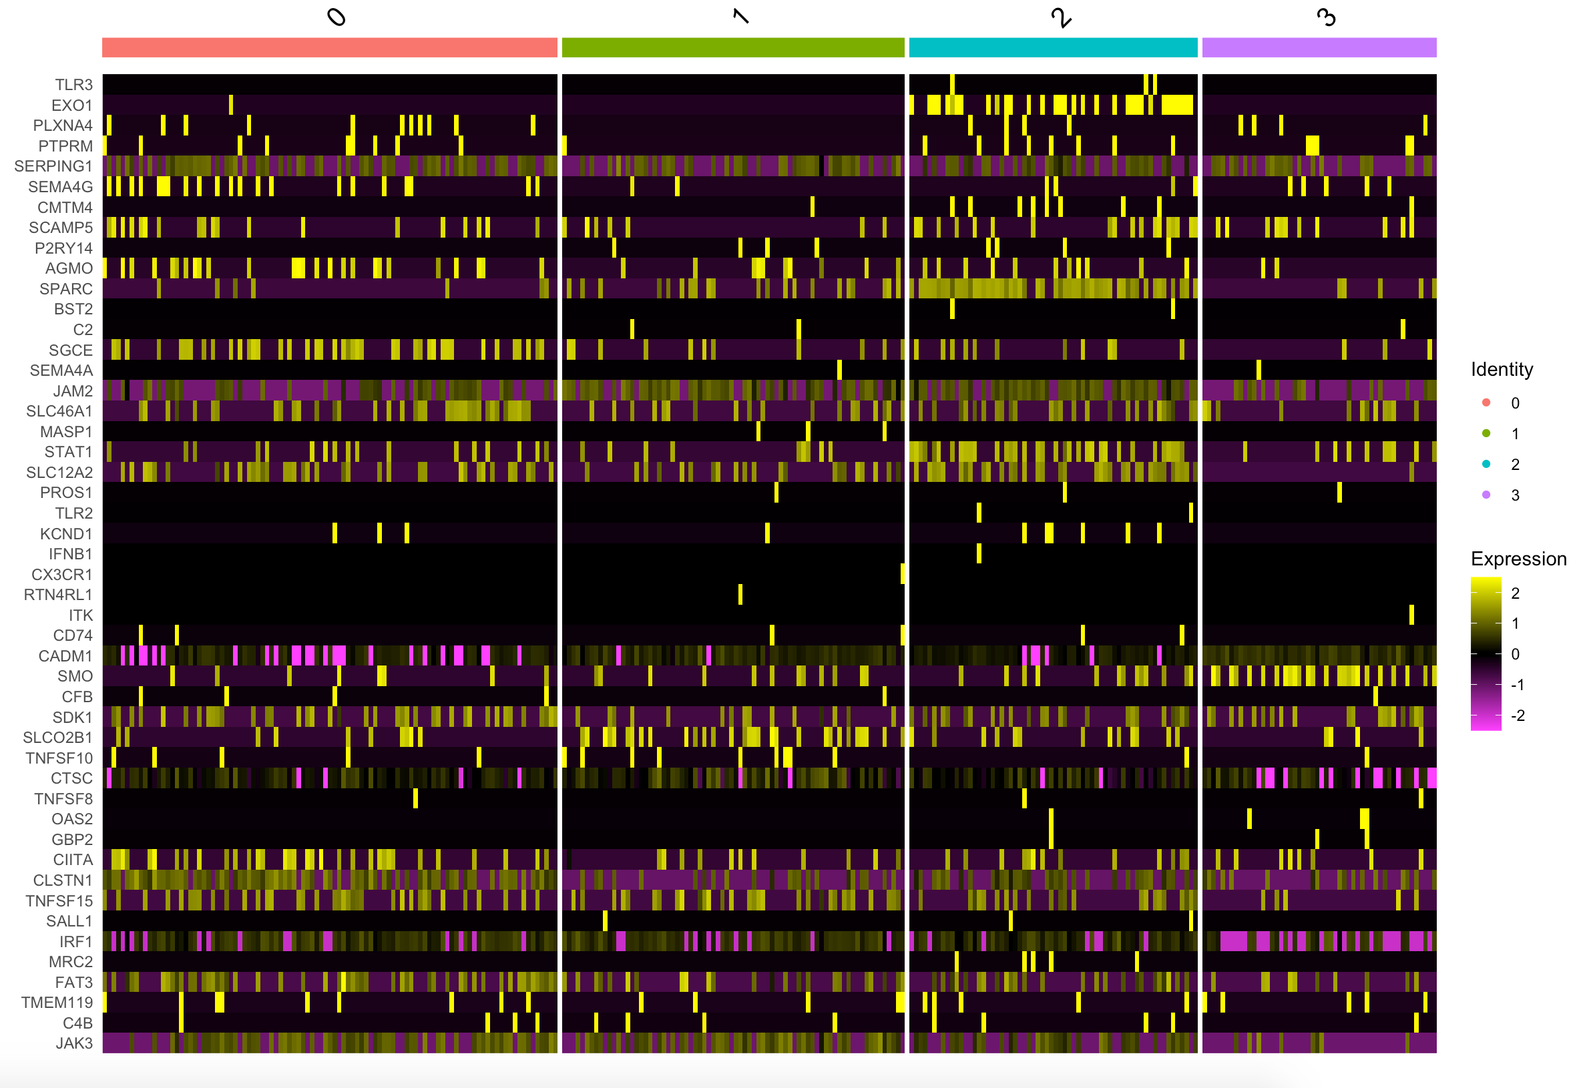
SHH Heatmaps (Updated)
SHH-infant (beta) Male, 4yo Sample ID: MUV41 | SHH-infant (beta) Male, 3yo Sample ID: SJ454 | SHH-adult (delta) Male, 13yo Sample ID: SJ577

Slide 5
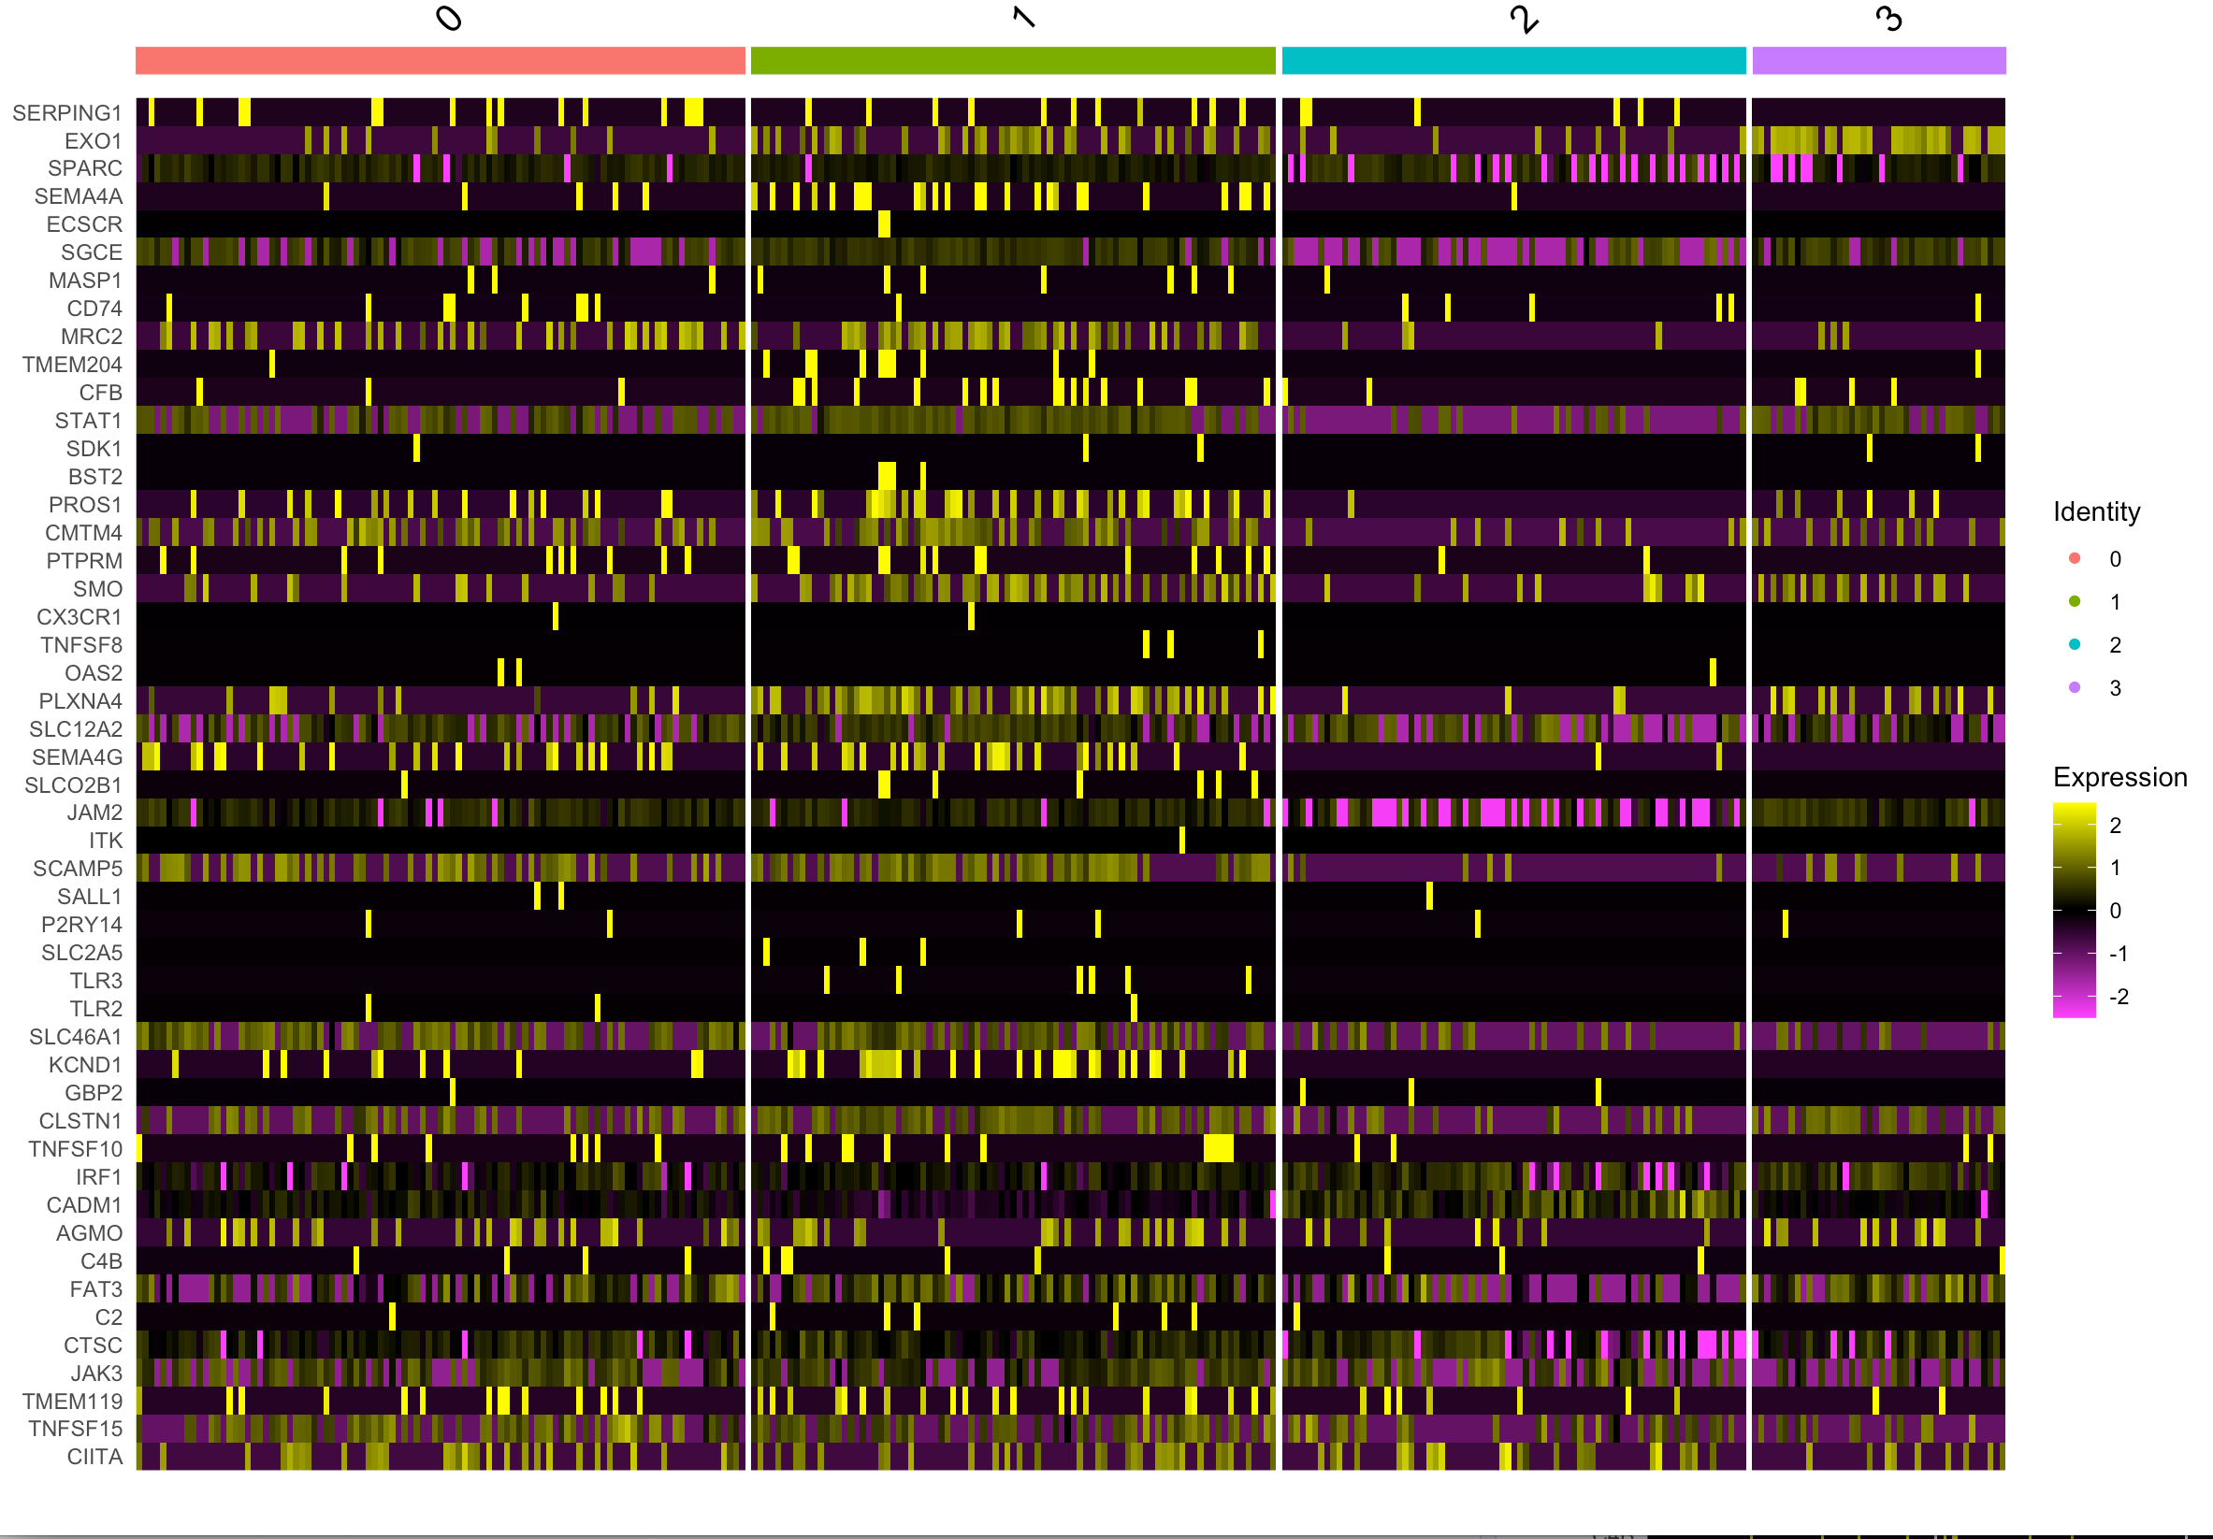
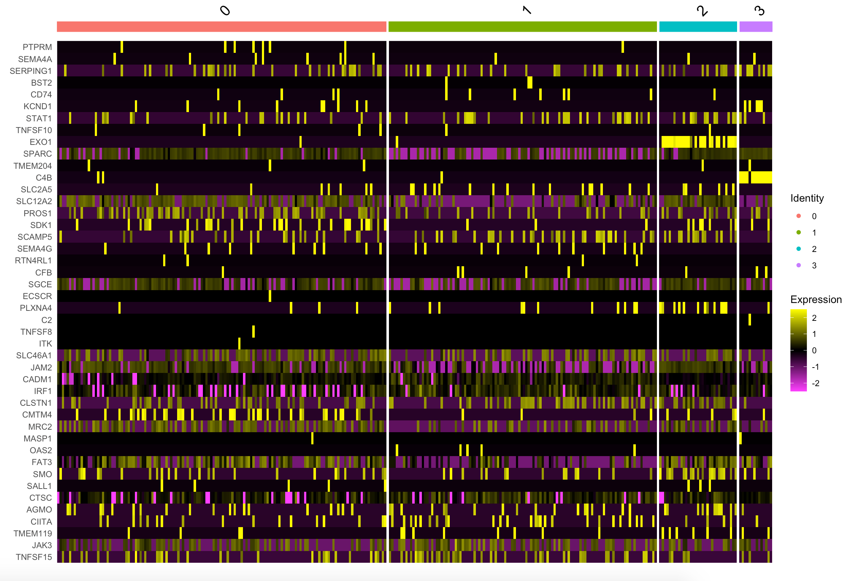
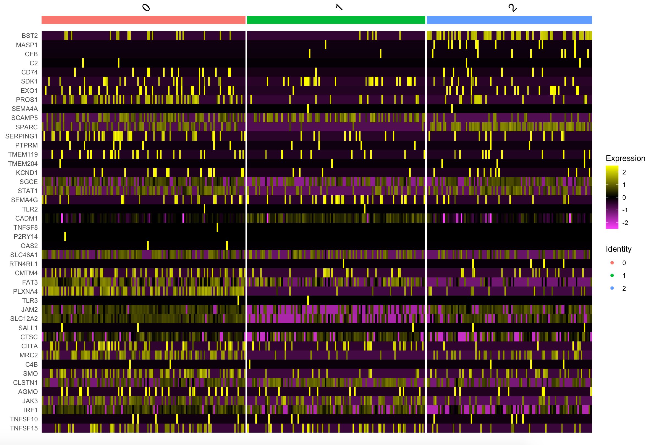
WNT Heatmaps (Updated)
Male, 12yo Sample ID: BCH807 | Male, 9yo Sample ID: MUV44 | Male, 17yo Sample ID:SJ99

Slide 6
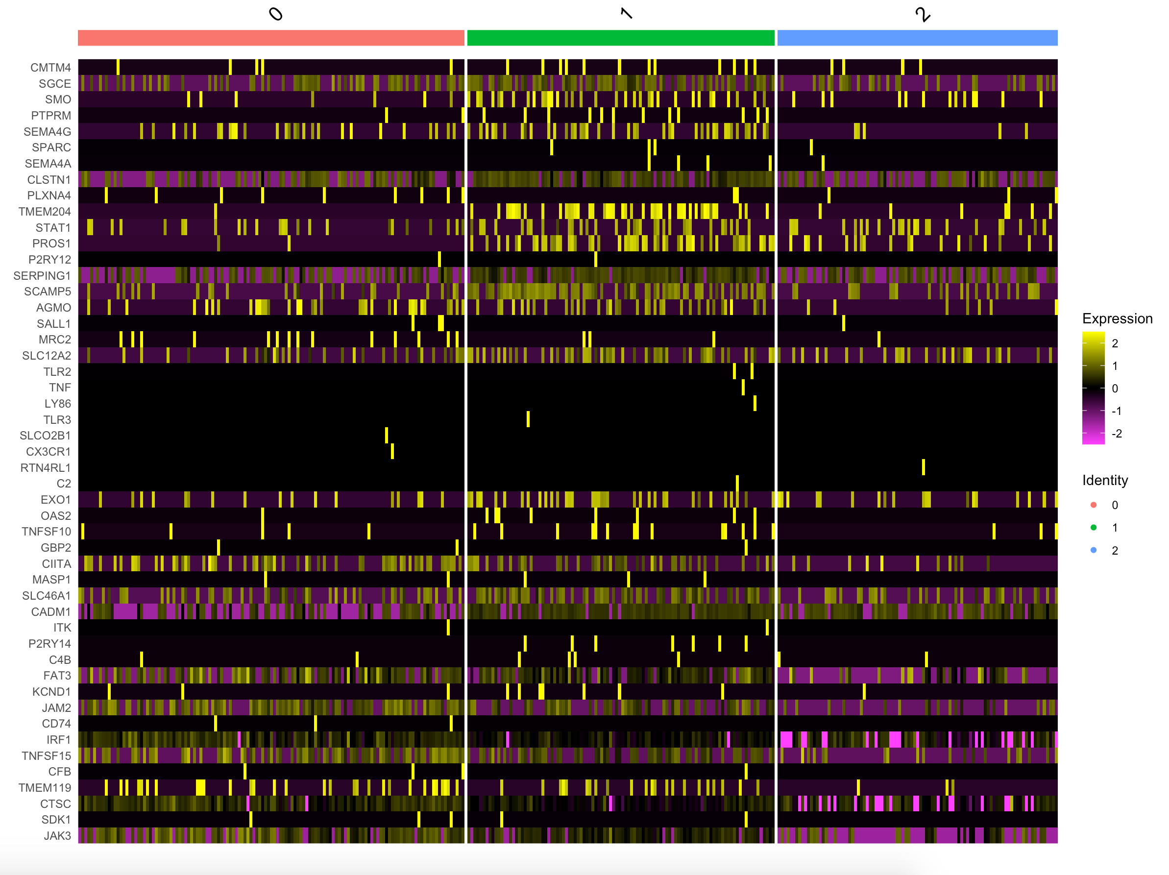
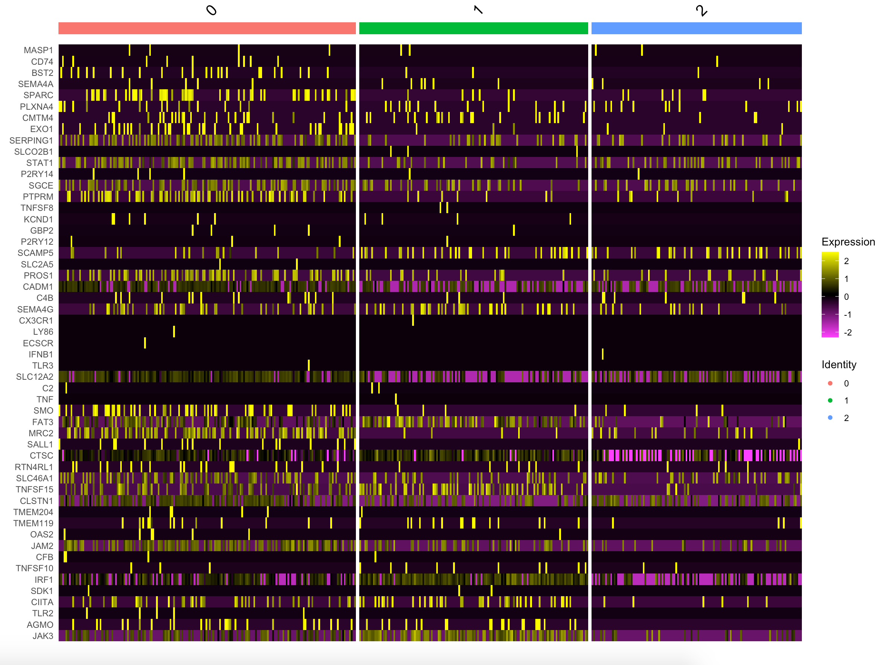
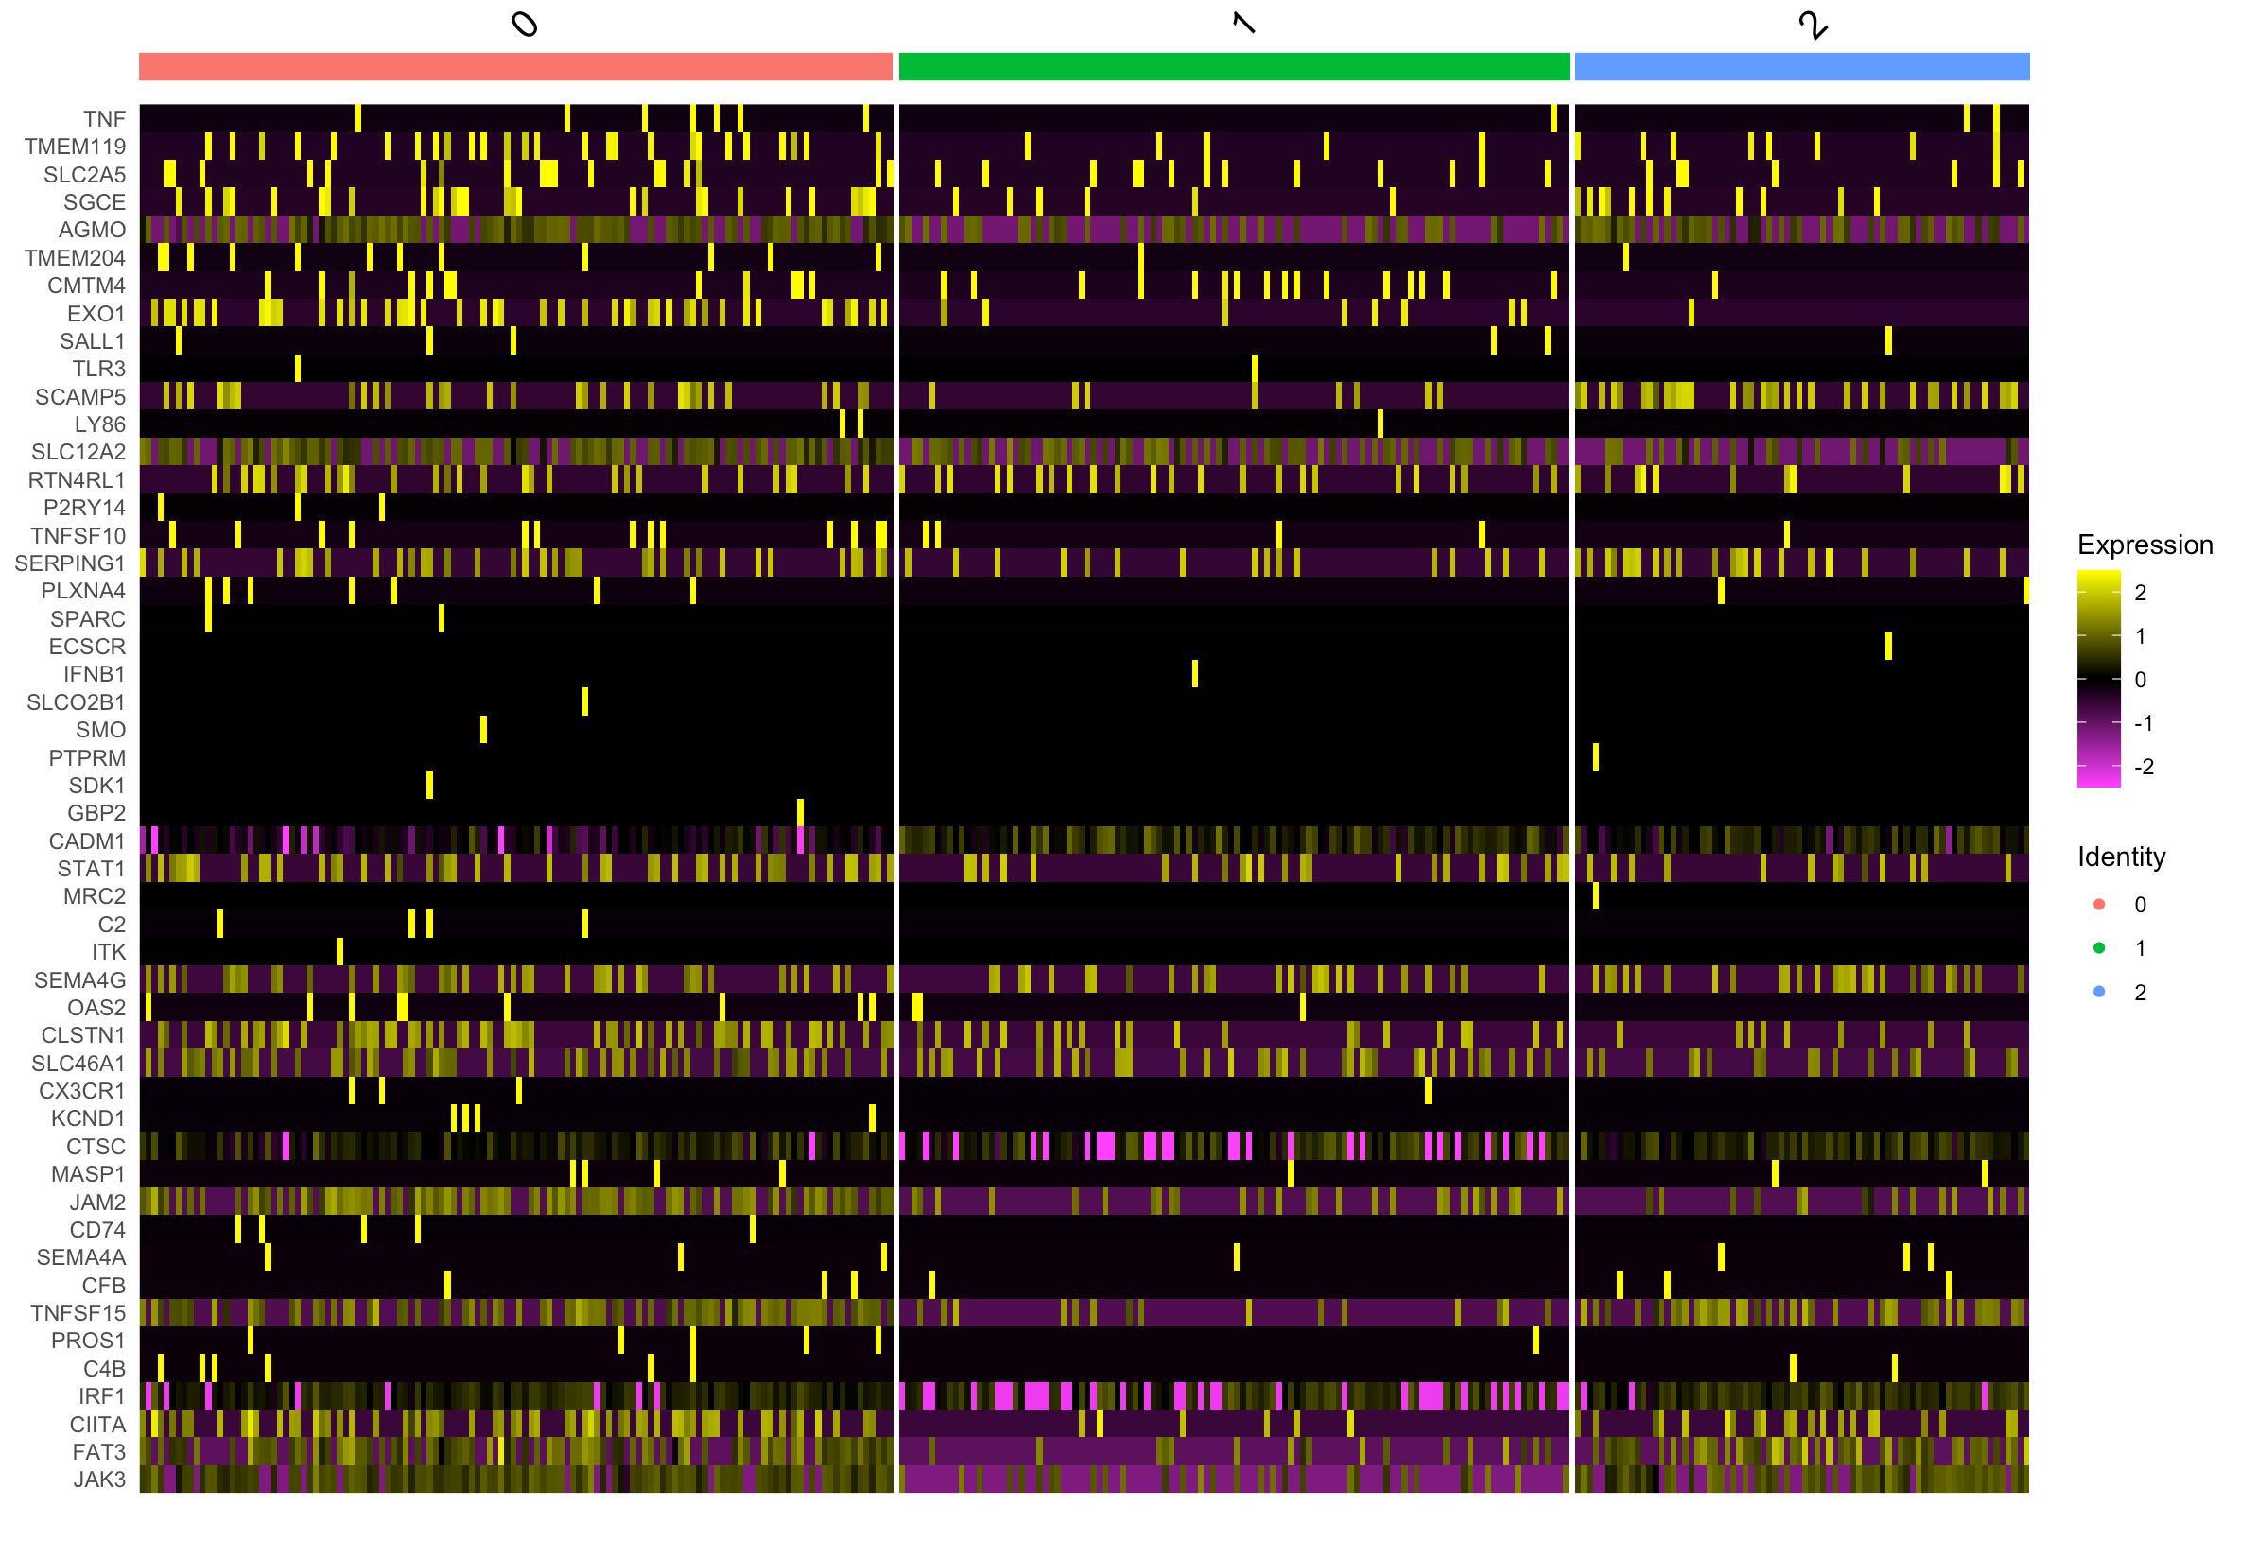
G3 Heatmaps (Updated)
Methylation subtype V Male, 8yo Sample ID: BCH825 | Methylation subtype II Male, 6yo Sample ID: MUV11 | Methylation subtype II Female, 4yo Sample ID: MUV29

Slide 7
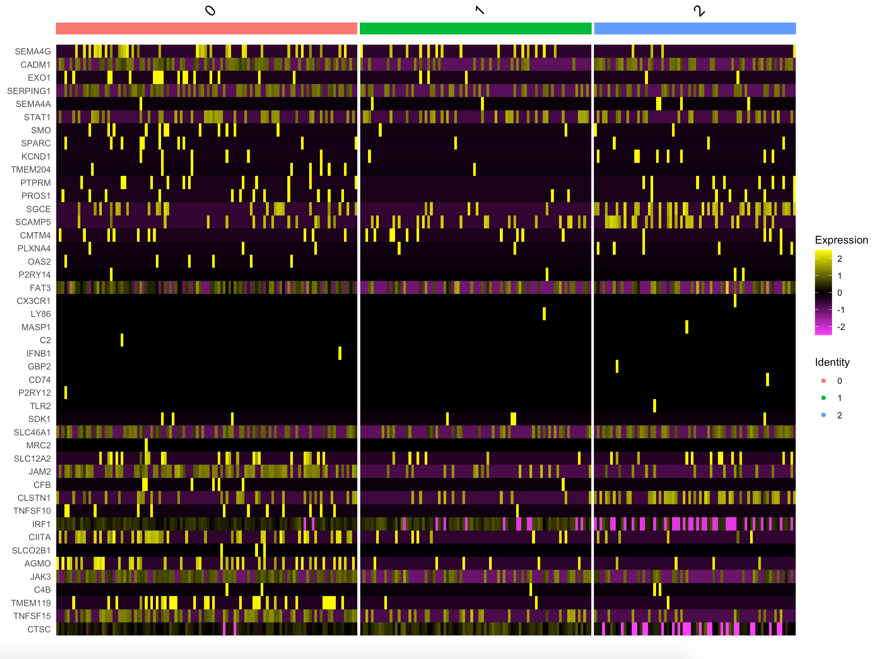
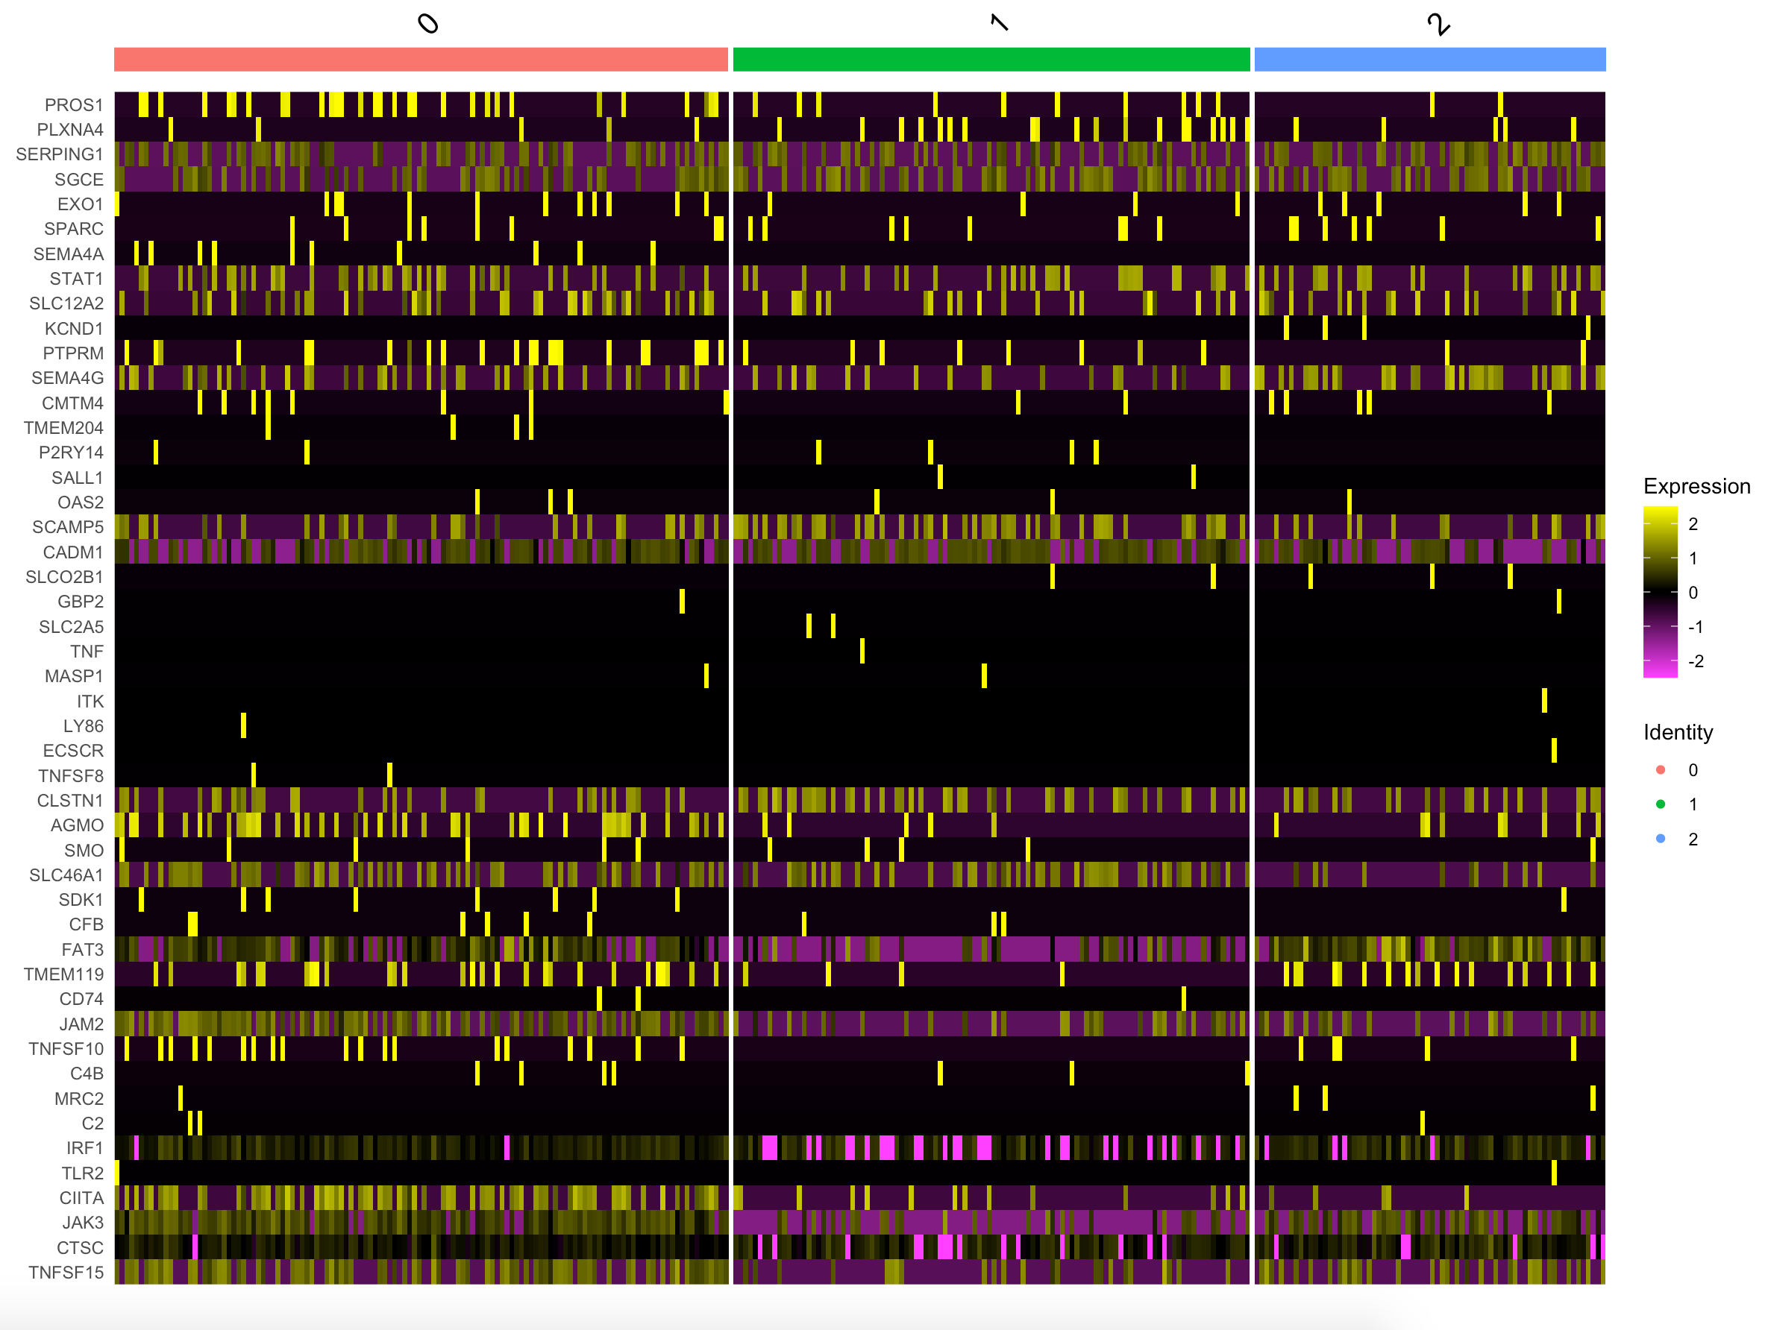
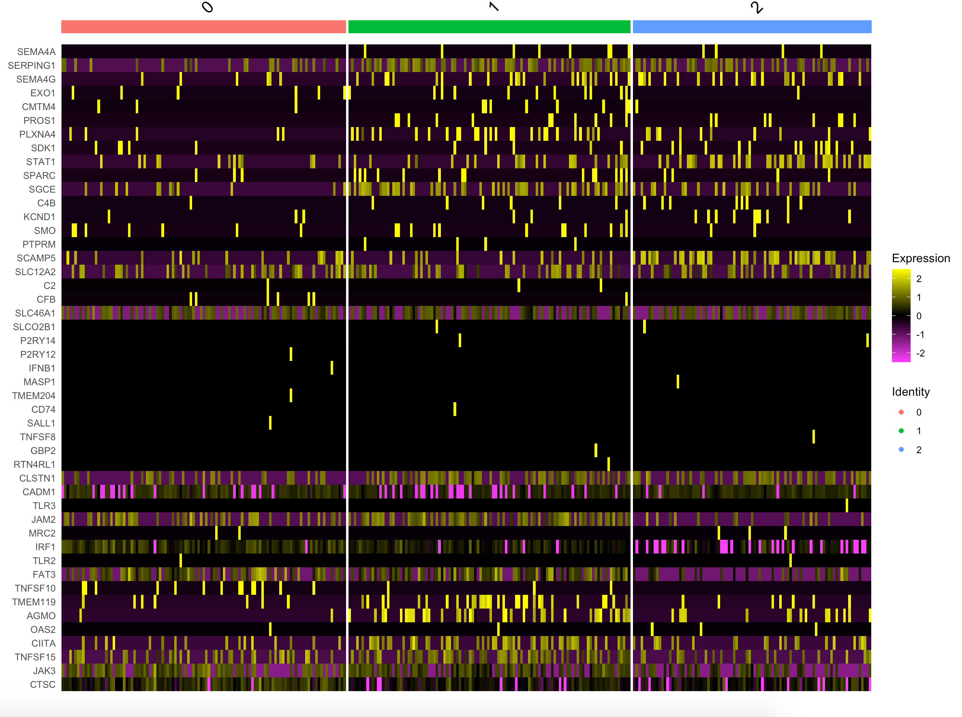
G4 Heatmaps (Updated)
Methylation subtype VIII Male, 12yo Sample ID: BCH1031 | Methylation subtype VIII Male, 16yo Sample ID: MUV19 | Methylation subtype VIII Female, 7yo Sample ID: MUV27

Slide 8
Cluster Information
Sample | IMM cluster # | Number of cells in IMM cluster
SHH MUV41 | C3 | 59
SHH SJ454 | C2 | 64
SHH SJ577 | C4 | 62
WNT BCH807 | C1 | 87
WNT MUV44 | C2 | 33
WNT SJ99 | C0 | 126
G3 BCH825 | C1 | 104
G3 MUV11 | C0 | 174
G3 MUV29 | C0 | 126
G4 BCH1031 | C0 | 112
G4 MUV19 | C0 | 126
G4 MUV27 | C1 | 110

Slide 9
Microglial Specific Gene Information
To assign microglia probability/ order the cells in IMM clusters in terms of highest microglial expression to lowest microglial expression, need to look at average expression for the following genes:
TMEM119¹ → reliable microglial marker that discriminates resident microglia from blood-derived macrophages. Elevated expression in response to neurodegenerative diseases (such as Alzheimer’s). Is not expressed by macrophages
Serping1²→ increased expression due to microglia abundance. Enrichment of this gene has to do with wound healing (immune response)
P2RY12³ → P2RY12-positive microglia mostly had non-activated morphologies, while the morphologies of P2RY12-positive microglia in AD brains were highly variable, suggesting its expression could encompass a wider range of phenotypes than originally hypothesized
Jak3⁴→ regulates microgliogenesis, microglial migration and phagocytosis. Should have higher expression levels of JAK3 in the presence of microglia.
CX3CR1⁵→ microglia are characterized by prominent expression of chemokine receptor (CX3CR1). Expressed in multiple areas of the body but are highly cell type specific in tissues. in the central nervous system, this is only expressed in microglia (brain and spinal cord)
Satoh J, Kino Y, Asahina N, et al. TMEM119 marks a subset of microglia in the human brain. Neuropathology. 2016;36(1):39-49. doi:10.1111/neup.12235
Anirudh Patir, Barbara Shih, Barry W. McColl, Tom C. Freeman. bioRxiv 308908; doi: https://doi.org/10.1101/308908
Walker DG, Tang TM, Mendsaikhan A, et al. Patterns of Expression of Purinergic Receptor P2RY12, a Putative Marker for Non-Activated Microglia, in Aged and Alzheimer's Disease Brains. Int J Mol Sci. 2020;21(2):678. Published 2020 Jan 20. doi:10.3390/ijms21020678
Barua S, Chung JI, Kim AY, Lee SY, Lee SH, Baik EJ. Jak kinase 3 signaling in microgliogenesis from the spinal nestin+ progenitors in both development and response to injury. Neuroreport. 2017;28(14):929-935. doi:10.1097/WNR.0000000000000854
Wolf Y, Yona S, Kim KW, Jung S. Microglia, seen from the CX3CR1 angle. Front Cell Neurosci. 2013;7:26. Published 2013 Mar 18. doi:10.3389/fncel.2013.00026

Slide 10
Next Steps
Now that I have identified the IMM clusters, I want to figure out how to order the cells from highest to lowest microglia specific marker expression. This means I have to use the specific genes on the previous slide (along with a few more) to do this. I could either use a sum or assign a probability score and order the cells based on this. I do not want to filter out cells from the IMM cluster though, because even if a cell has little to no microglia specific expression this may still be an inactivated (resting state) microglia.
Following this, I want to force all of the heatmaps to have the same gene order so I can do a direct comparison across samples.

Slide 11
Sources
Satoh J, Kino Y, Asahina N, et al. TMEM119 marks a subset of microglia in the human brain. Neuropathology. 2016;36(1):39-49. doi:10.1111/neup.12235
Anirudh Patir, Barbara Shih, Barry W. McColl, Tom C. Freeman. bioRxiv 308908; doi: https://doi.org/10.1101/308908
Walker DG, Tang TM, Mendsaikhan A, et al. Patterns of Expression of Purinergic Receptor P2RY12, a Putative Marker for Non-Activated Microglia, in Aged and Alzheimer's Disease Brains. Int J Mol Sci. 2020;21(2):678. Published 2020 Jan 20. doi:10.3390/ijms21020678
Barua S, Chung JI, Kim AY, Lee SY, Lee SH, Baik EJ. Jak kinase 3 signaling in microgliogenesis from the spinal nestin+ progenitors in both development and response to injury. Neuroreport. 2017;28(14):929-935. doi:10.1097/WNR.0000000000000854
Wolf Y, Yona S, Kim KW, Jung S. Microglia, seen from the CX3CR1 angle. Front Cell Neurosci. 2013;7:26. Published 2013 Mar 18. doi:10.3389/fncel.2013.00026

